Slide 1


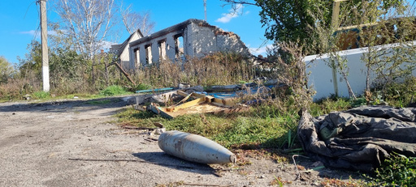
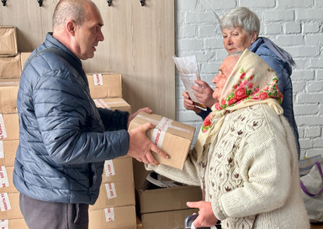
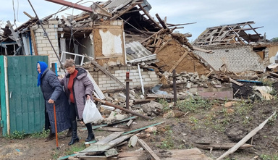
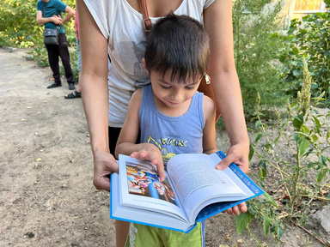
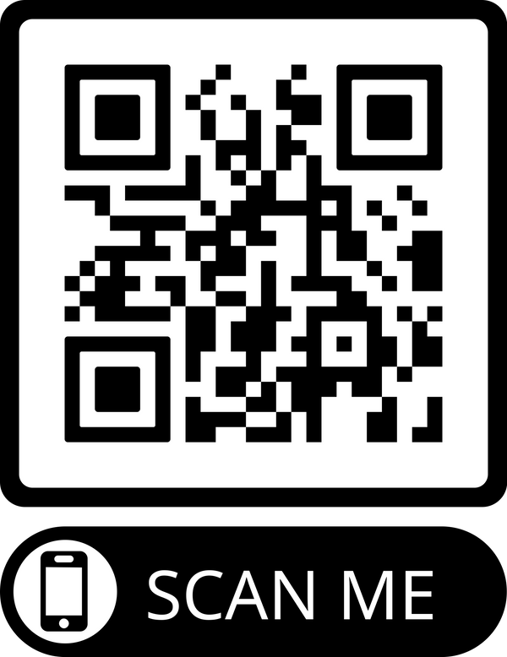




Make a Global Kingdom Impact at IC M 2025!
Help us fill a 40-foot container full of supplies to send to Ukraine!!
Items Needed - All items must be new!
  Hygiene: shampoo, soap, body wash, toothbrush, wet wipes, toothpaste, laundry detergent, diapers size 1-6, feminine pads, sanitizer
  Medical Supplies: antiseptic, anti-inflammatory, pain/fever-reducer, antihistamine, cold and venotonic medicine, eye drops, vitamins, topical gel/cream for joint/muscle pain
  Electrical: flashlights (no batteries)
  Bedding, Blankets, Pillows, & Towels
  Clothing: winter coats, jackets, shoes (children or adult size 10+)
You’re able to have a direct blessing on the Global Church thanks to the partnership and dedication of these great organizations!
Scan this code to find out about drop off donation centers and deadlines!

